Slide 1
Mobilizing Nurses For Climate Action: What you can do about the climate crisis
Gideon Forman, Climate Change Policy Analyst
Kim Jarvi, RNAO Senior Economist
Hilda Swirsky, ONEIG volunteer, liaison to CANE

Slide 2
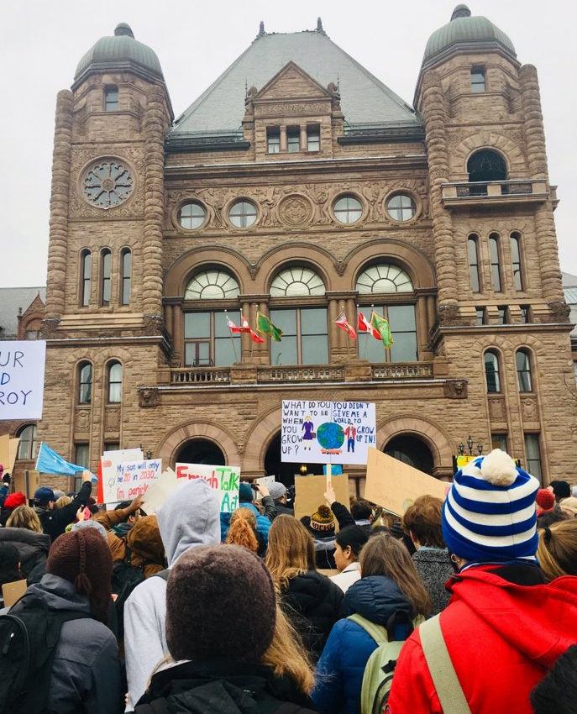
Overview
Inspiration for nurses from students as environmental advocates
Overview of climate change –timelines for mitigation action
Health impacts
Climate solutions and what you can do (Hint: vote!)
Photo: David Suzuki Foundation

Slide 3
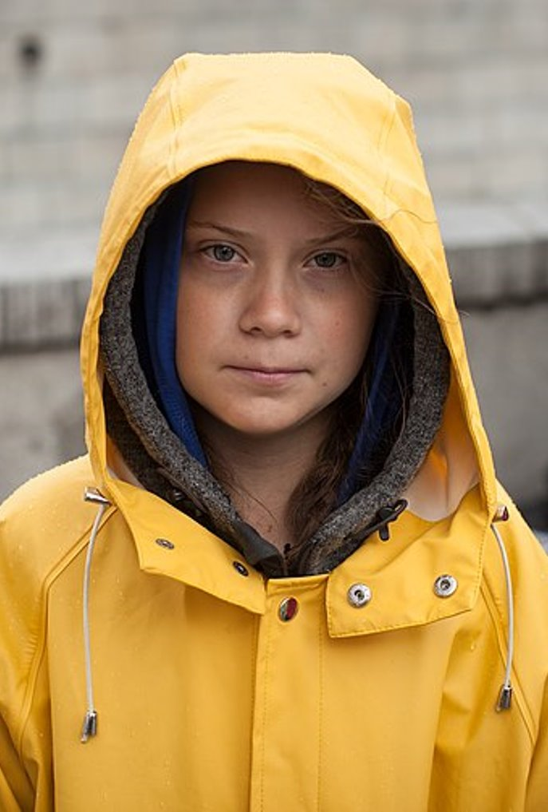
Students as environmental advocates
Great news: youth climate action builds momentum!​
Huge inspiration is Greta Thunberg, 16-year-old Swede who launched "school strike" because her gov't wasn't doing enough to cut emissions. Nominated for Nobel Prize.​
Students in over 100 countries now doing "Fridays for Future" rallies to make climate a priority. ​
Take-away: Never underestimate your power. If you speak out – and vote – we can become a thriving, low-carbon society!
Photo: anderspangpang (Wikimedia commons)​

Slide 4
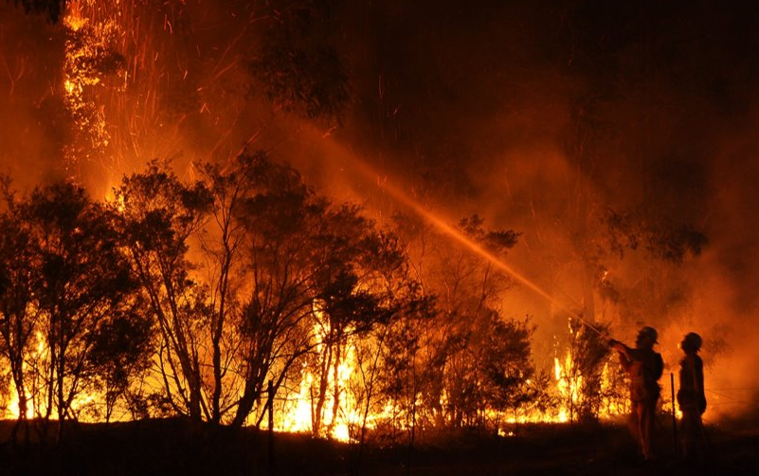
Overview of climate change
Defining challenge of our age. Science foresees over 3 C warming this century, which could be "catastrophic." (Scientific American, Jan 2019) ​
New prediction: "Threats to people's health and safety will increase, storm damage will get more extensive and crops needed to feed a rising population will be ruined.” (Prediction for 2050. Michael Mann, Scientific American, March 2019)​
“Migrations forced by climate change could very well become the most important humanitarian challenge of the 21st century.” (Scientific American, January 2011)​
Photo: Quarrie Photography​

Slide 5
Timelines for mitigation action
Intergovernmental Panel on Climate Change (IPCC) examined impact of 1.5 and 2.0$°$C warming in report released fall 2018
Conclusions:
1.5$°$C would amplify all the effects we are experiencing now
2.0°C impacts far greater for ecological systems and human health
Example: with 2.0°C warming, several hundred million more people would be exposed to climate related risks and susceptible to poverty by 2050
Photo: Photosforclass.com, Wikimedia commons​

Slide 6
Timelines for mitigation action
Paris Agreement 2015 $→$Under the United Nations Framework Convention on Climate Change 197 signatory countries agreed to hold global warming below 2 °C and pursue efforts to limit global warming to 1.5°C
We are 11 years from 1.5°C
Current trajectories have world on course for 2.6 to 4.8$°$C of warming by 2100
To prevent 2$°$C, the IPCC concluded to :
Cut emissions by 45% by 2030
Cut emissions to zero by 2050
Source: IPCC FAQ

Slide 7
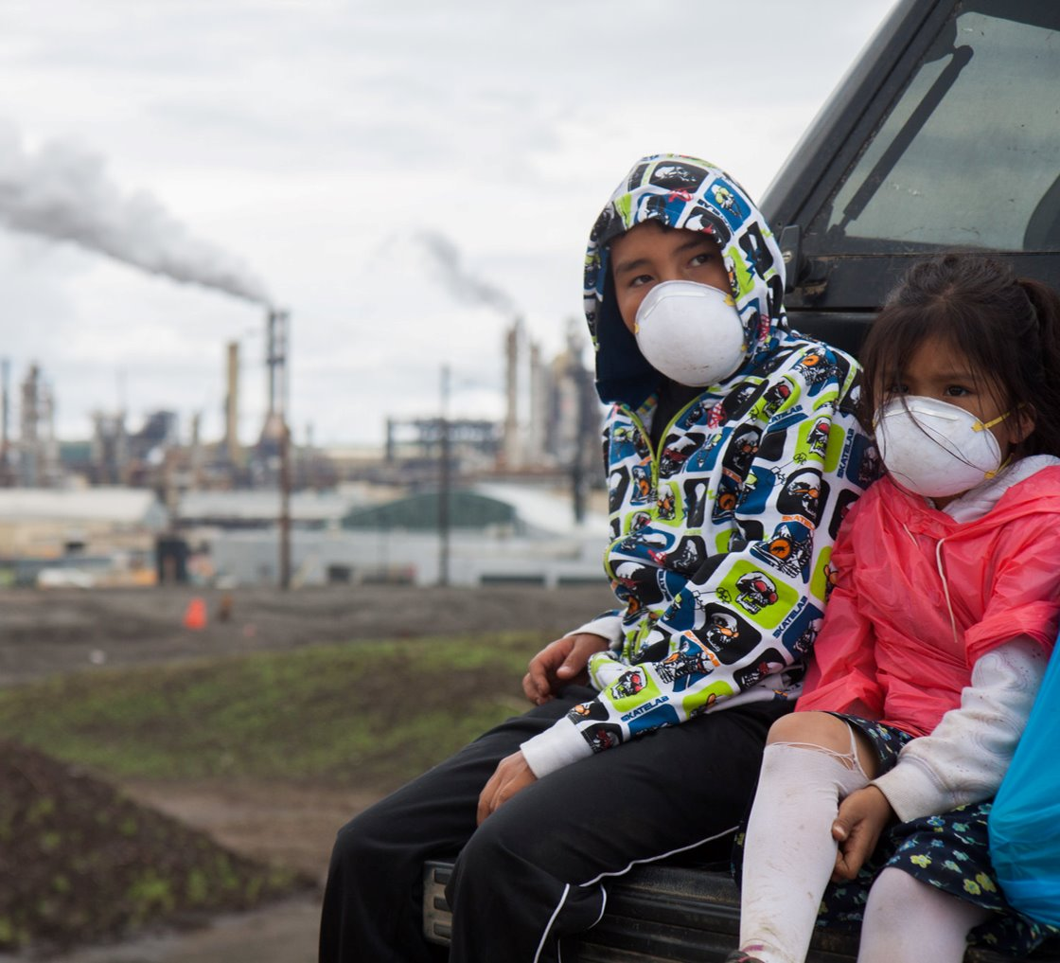
Health impacts of climate change: air and heat
More smog, and particulate matter in smog is cause of lung cancer. ​
More heat-wave deaths. (Already happening: In 2003, heat killed over 30,000 Europeans.)​
Lesser-known finding: heat reduces productivity. Over 150B hours of labour, mostly in agriculture, lost to heat in 2017. (Lancet, Dec 2018)​
Photo: Ben Powless

Slide 8
Health impacts of climate change: waterborne disease
If huge Antarctic glaciers crumble, could see 3.35m (11 ft) sea level rise in a few decades. Imagine flooding in coastal cities like Halifax. (Sci. Am., Feb 2019)​
Flooding, sewer overflow can release harmful organisms; e.g., fecal bacteria. ​
Warmer water permits more microbes' survival. ​
Photo: DVIDSHUB on flickr

Slide 9
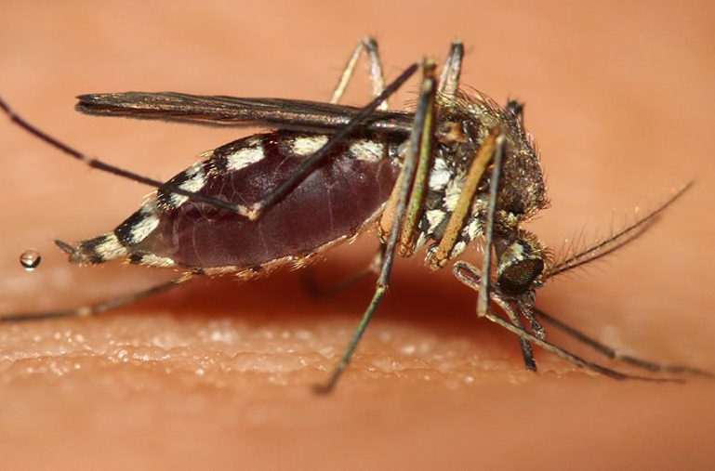
Health impacts of climate change: mosquitos and ticks
More West Nile virus predicted in Canada due to higher temperature and more grassland, which foster mosquito growth. (Chen, C.C. et al 2013, Intern.J. Environ. Res. and Public Health)​
Lyme disease expected to increase due to rising tick population attributed to milder weather. (Winter now less lethal to them.) (Leighton, P.A. et al 2012 J.Appl.Ecol) ​
Photo: Ngari.Norway on Wikimedia commons

Slide 10
A new tool for nurses – The Climate Crisis – NEJM Aug 22, 2019

Slide 11
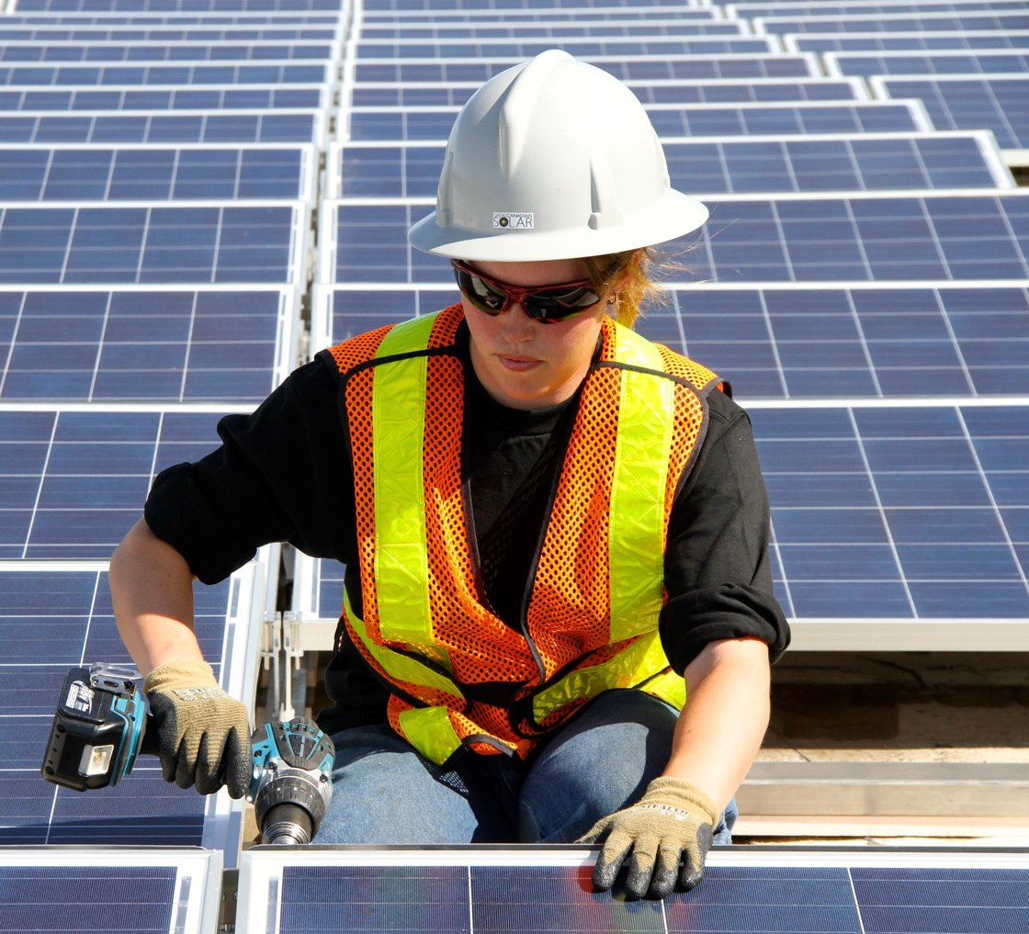
Climate solutions
The situation is serious but not hopeless. We can still avert the worst!​
Scientist Michael Mann: "If the world acts now to quickly get off the business-as-usual treadmill and significantly lower carbon emissions, we can avoid a catastrophic two degrees Celsius...warming." (Sci Am March 2019) ​
Good news: we already have many of the solutions, like non-emitting transport (electric cars, walking, cycling) and phasing out coal power. ​
Photo: Green Energy Futures

Slide 12
RNAO’s Federal Election Platform
RNAO urges nurses and the public to vote for candidates that commit to developing and implementing a comprehensive climate action plan that includes:
Establishing greenhouse gas emission targets consistent with current scientific evidence
Strengthening the national carbon pricing regime
Phasing out fossil fuel subsidies
Investing in green infrastructure, including public transit and active transportation
Visit: rnao.ca/federal-election-2019

Slide 13
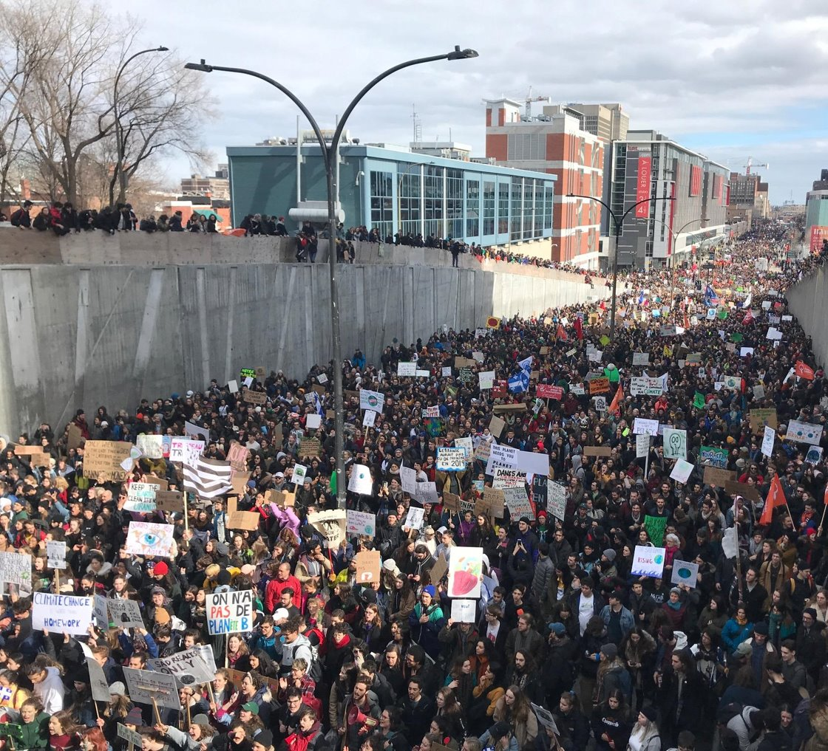
How YOU can help
Individual lifestyle changes (walking/riding bike, reducing meat consumption, avoid flying) are important BUT must be coupled with political change.
Write a letter to the editor urging climate action. ​
Join Fridays for Future or another local group. ​
Talk to family and friends about the climate crisis. ​
Demand climate solutions this election. See https://davidsuzuki.org/action/jobs-justice-clean-energy/​
Vote in the federal election! Protect loved ones by casting a ballot Oct. 21. ​
Photo: David Suzuki Foundation

Slide 14
Make It Better OPHA Campaign
Visit: makeitbetterontario.ca

Slide 16
On October 21, be sure to vote!
Register to vote – it's quick and easy. Visit https://ereg.elections.ca/​
Make voting plan: ​
A) Find buddy — right now! — to vote with ​
B) Decide what time you'll vote (ideally in advance poll)​
C) Find out voting location​
D) Tell friends you're voting!​

Slide 17
Text VOTE19 to 39 39 39
for text message updates from the David Suzuki Foundation.
Standard data and message rates may apply.
Text STOP to quit or HELP for information.

Slide 18
Advocacy Action Toolkit
We all need to spread the word and encourage climate action!
Toolkit includes:
A generic version of this presentation.
Reference list of advocacy tools to help you effective engage (i.e. how to write letter to editor)
Toolkit to be sent to all webinar participants! Share your kit!

Slide 19
Thank you!
Happy to answer any questions.​
Follow the David Suzuki Foundation on: ​
Facebook @DavidSuzukiFoundation ​
Twitter @DavidSuzukiFDN​
Instagram: @davidsuzukifdn​
Find out more about volunteering with ONEIG!
Email: oneigrnao@gmail.com
Facebook @ONEIGRNAO
Thanks to Dr. Scott Findlay (University of Ottawa) for his "All-party climate caucus briefing: Potential impacts of climate change on the health of Canadians" which proved useful in preparing this presentation. ​

